Slide 1
AR Indoor Navigation for
SKKU Suwon campus
team E: 김현호 마준서 안정민 조민구

Slide 2
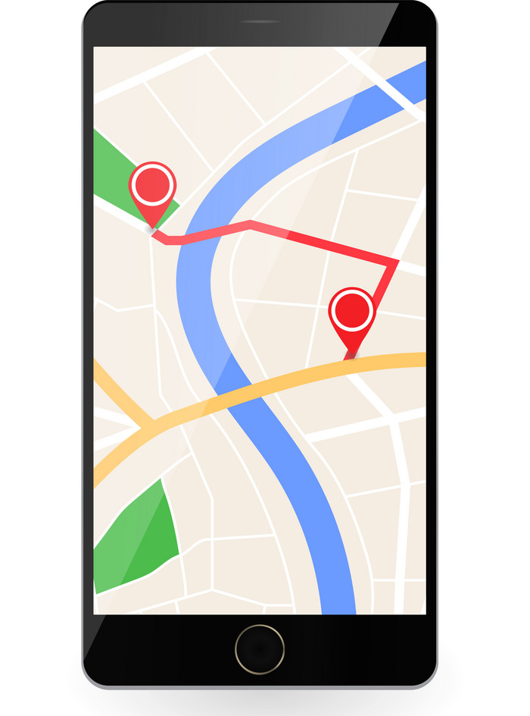
Contents
Project Objectives
Members Role Introduction
App Flow
Implementation and Challenges
Limitation
To Do
Demo Video

Slide 3
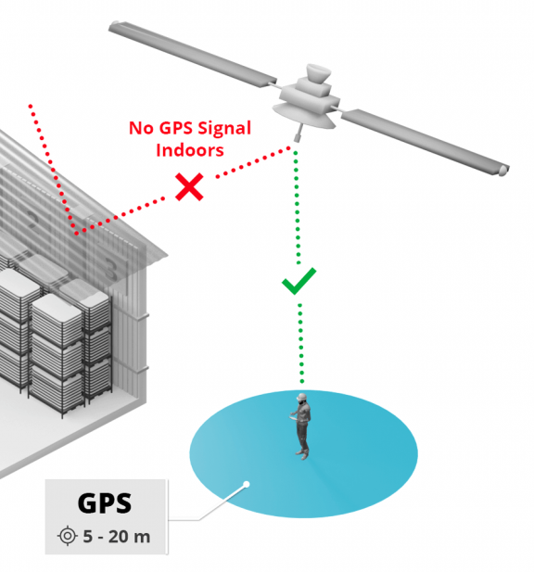
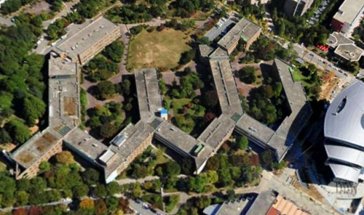
Project Objectives
-Problem 1
거대하고 반복적인 실내 구조와 랜드마크의 부재는 사용자의 현재 위치에 대한 방향감각을 저하시켜 길을 쉽게 찾지 못하게 한다
-Problem 2
실내에서는 GPS 신호를 수신할 수 없어 기존 GPS 바탕의 길 안내가 불가능하다
-Problem 3
기업 단위의 실내 네비게이션 솔루션은 근시일 내로 서비스를 기대할 수 없다

Slide 4
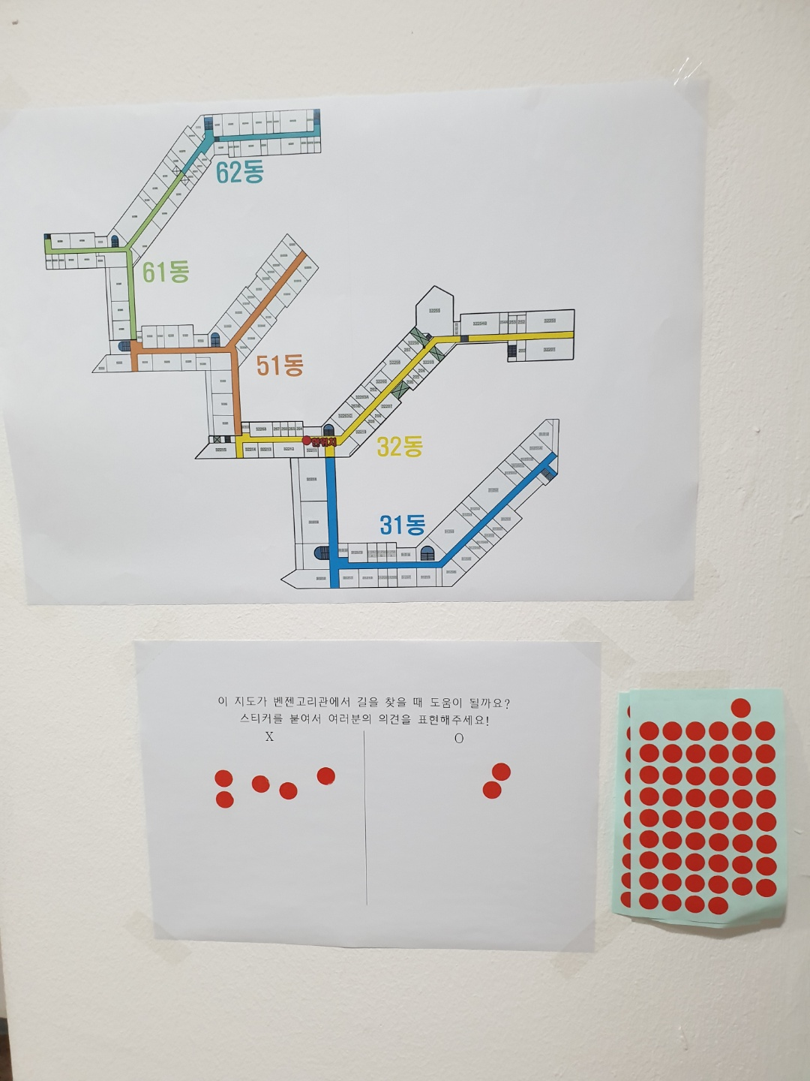
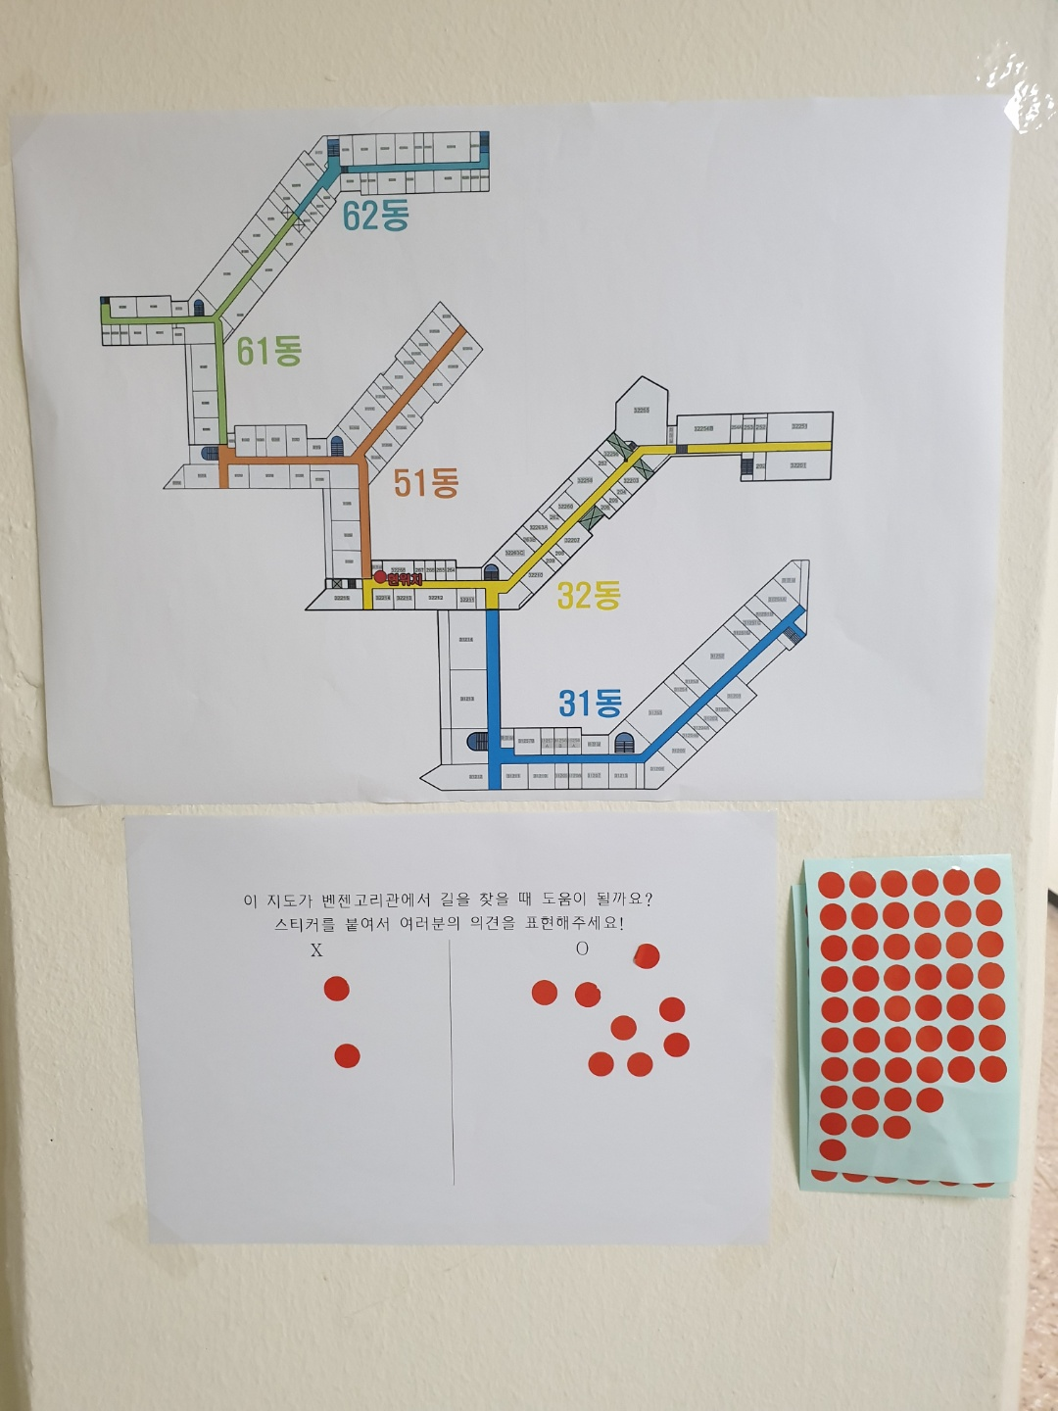
Project Objectives
-Problem 1
거대하고 반복적인 실내 구조와 랜드마크의 부재는 사용자의 현재 위치에 대한 방향감각을 저하시켜 길을 쉽게 찾지 못하게 한다
-Problem 2
실내에서는 GPS 신호를 수신할 수 없어 기존 GPS 바탕의 길 안내가 불가능하다
-Problem 3
기업 단위의 실내 네비게이션 솔루션은 근시일 내로 서비스를 기대할 수 없다

Slide 5
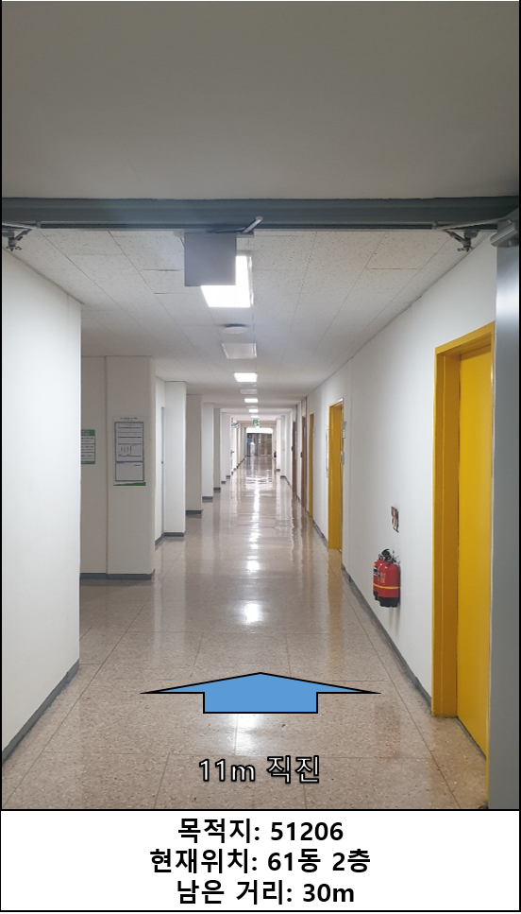
Project Objectives
-Target
신입생, 외부인 등 건물의 초행 방문자
-Objective
GPS 없이 실내 data를 바탕으로 사용자의 Indoor Positioning 과 Navigate를 수행
증강현실을 통한 직관적인 Navigate을 제공

Slide 6
Members Role Introduction
AR Development & Mapping | 마준서, 김현호
AR marker recognition | 안정민
AR Anchor | 조민구
Navigation algorithm | 안정민, 김현호
Create app flow, UI/UX | 마준서, 조민구
Campus Survey and Find Reference | 모두

Slide 7
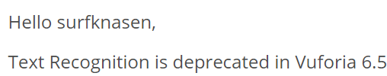


Members Role Introduction
AR Development & Mapping | 마준서, 김현호
AR marker recognition | 안정민
AR Anchor | 조민구
Navigation algorithm | 안정민, 김현호
Create app flow, UI/UX | 마준서, 조민구
Campus Survey and Find Reference | 모두

Slide 8

Members Role Introduction
AR Development & Mapping | 마준서, 김현호
AR marker recognition | 안정민
AR Anchor | 조민구
Navigation algorithm | 안정민, 김현호
Create app flow, UI/UX | 마준서, 조민구
Campus Survey and Find Reference | 모두

Slide 9
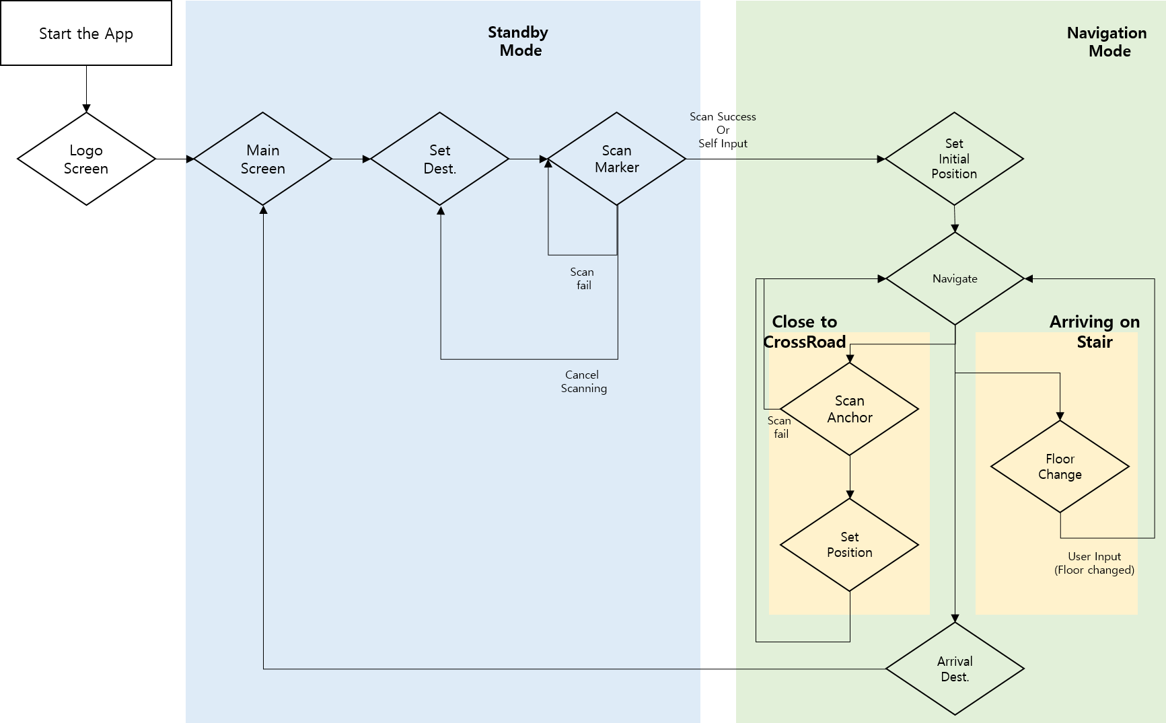
App Flow

Slide 10
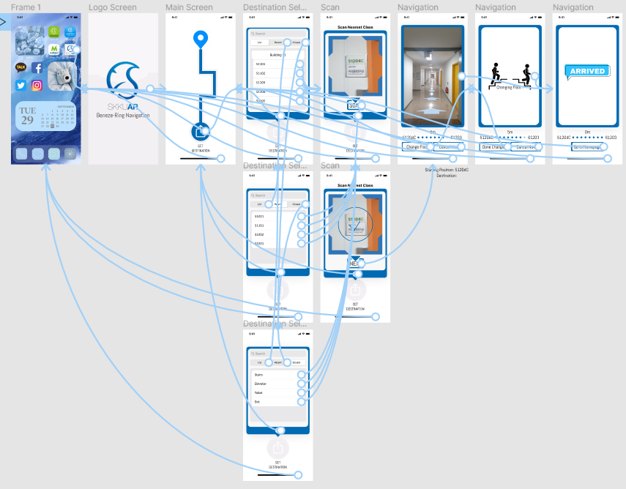
App Flow

Slide 11
Implementation and Challenges
Mapping
Indoor Positioning
Navigating
-Custom map for navigation
-Set data about core location
-Identify user’s position
-Check starting point & Error correction
-Navigation algorithm
-UI/UX for AR environment
-Extra function

Slide 12
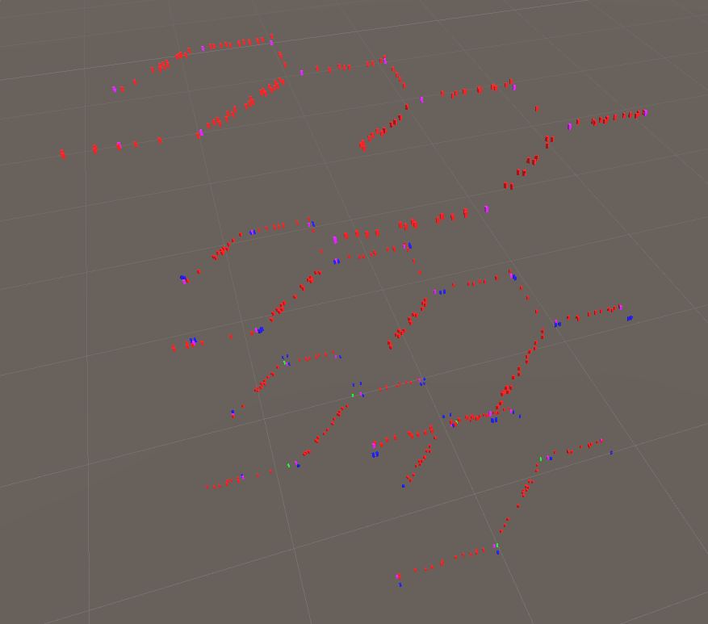
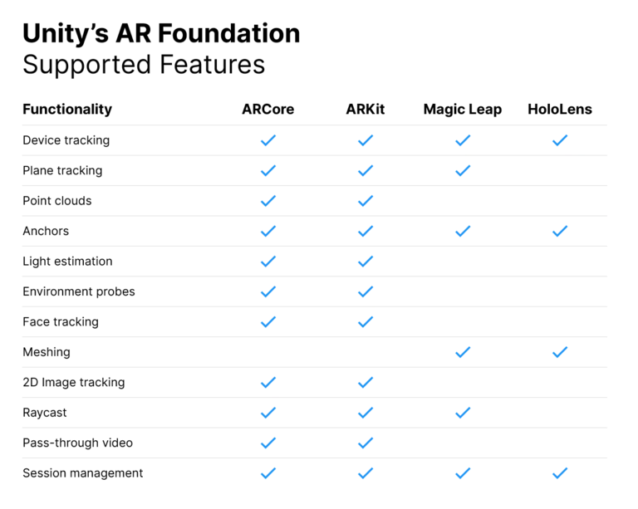

Implementation and Challenges-Mapping
Version: 2020.3.12f1 LTS
Language: C#
Mapping
AR Foundation
-Can import 3d mapping data and easy to see visually
-Can use both
AR Core(Android)
AR Kit(IOS) function
-Can build easily with multi-platform (Android and IOS)
AR Environment

Slide 13
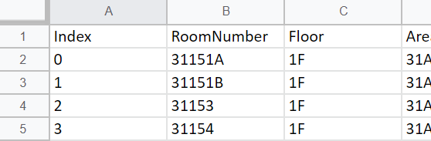
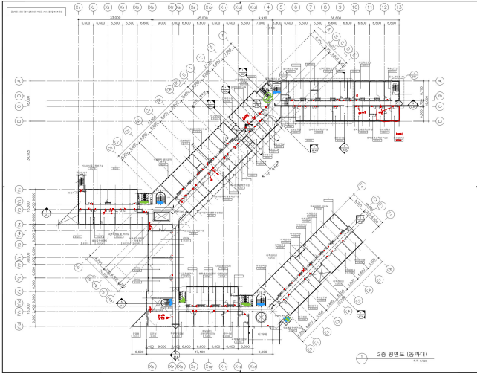
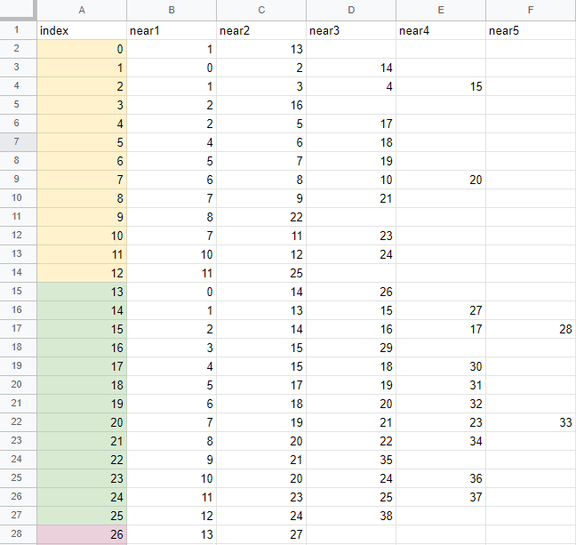
Implementation and Challenges
Implementation and Challenges-Mapping

Slide 14
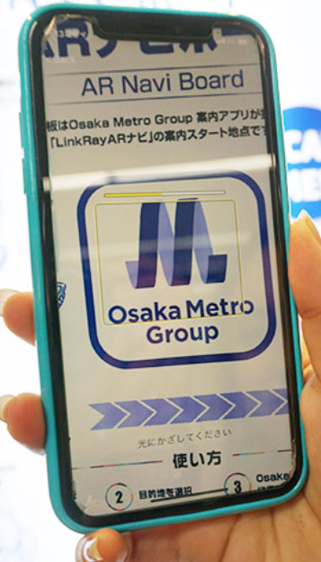
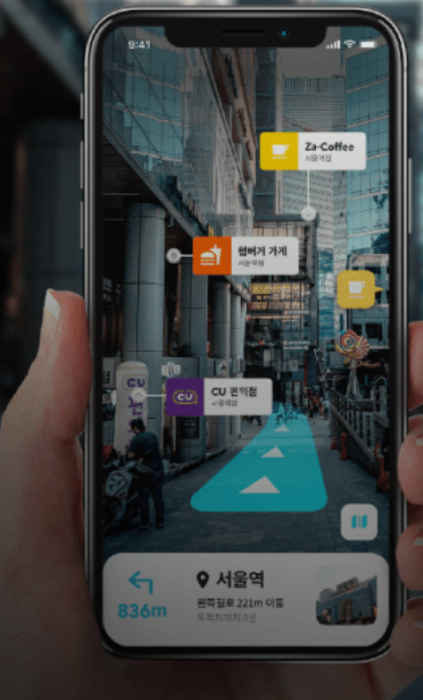
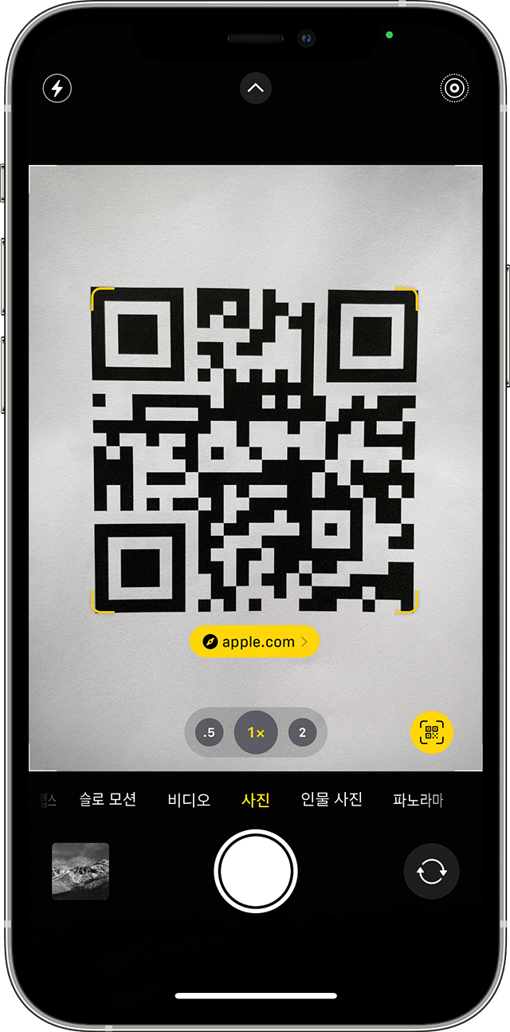
Implementation and Challenges-Indoor Positioning
Indoor Positioning
-Identify user’s position
-Check starting point & Error correction
General AR Marker: Characteristic and fixed images

Slide 15
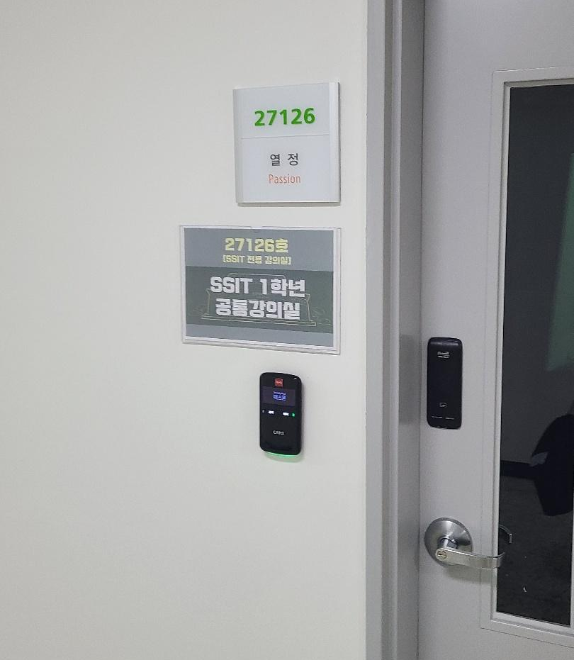
Implementation and Challenges-Indoor Positioning
Problem
Solution
-Need characteristic image for each location
-The storage of many images can slow Marker's perception
-Use door plates for marker

Slide 16




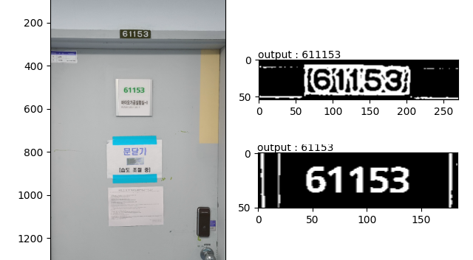
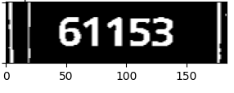
Implementation and Challenges-Indoor Positioning
5/9
Output: 61153

Slide 17

Implementation and Challenges-Indoor Positioning
OpenCV
-Real-time optimized Library for computer vision
-Use for pre-process camera image
Cloud Vision API
-Google’s image analysis API
-Provide functions like object detection, face detection, text detection etc…
-Use for text recognition

Slide 18

Implementation and Challenges-Indoor Positioning
Tesseract OCR
Pros
-Free
-Don’t need network connection
Cons
-Relatively slow
-No support for Unity
Google Cloud Vision API
Pros
-Fast
-High Perception Accuracy
Cons
-Not free
-Need network connection

Slide 19
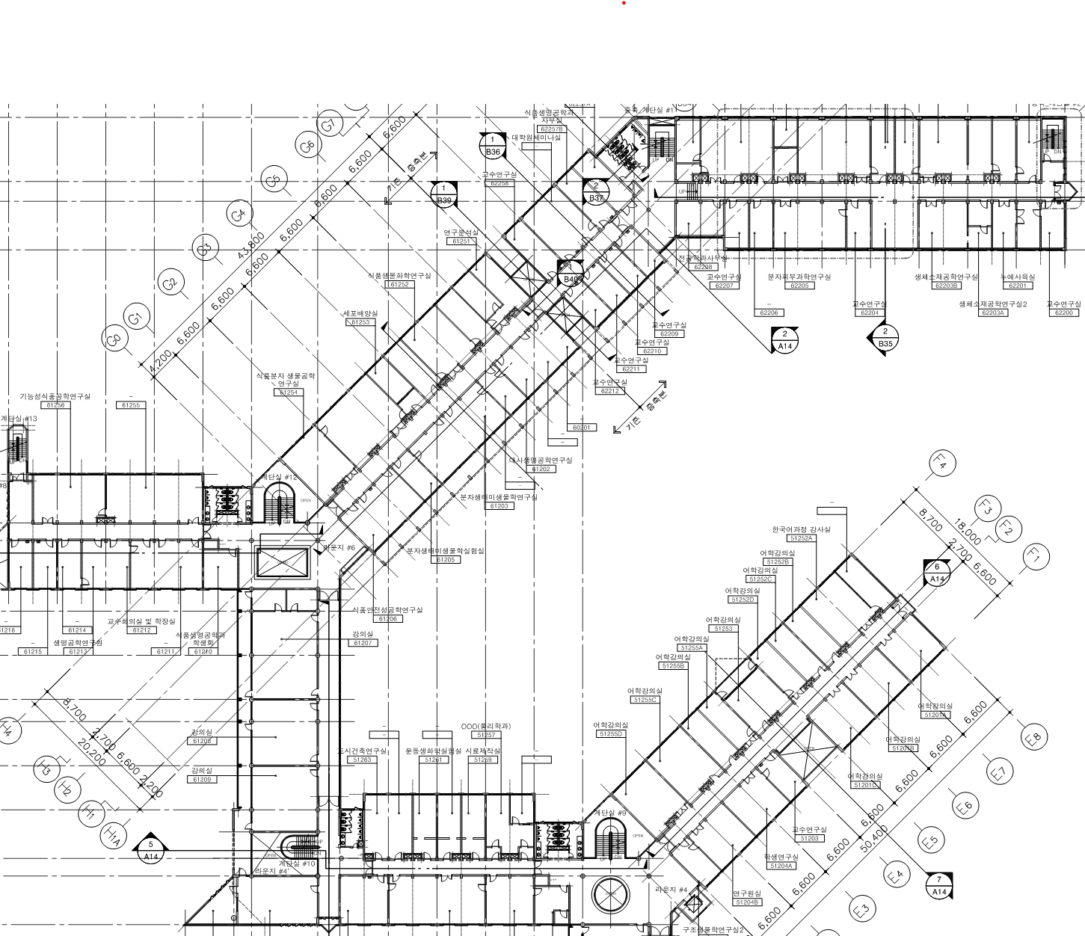


Implementation and Challenges-Navigating
Starting Position
Hallway 1
Navigating
Corridor 1
-Navigation algorithm
-UI/UX for AR environment
-Extra function
Hallway 2
Corridor 2
END Position

Slide 20
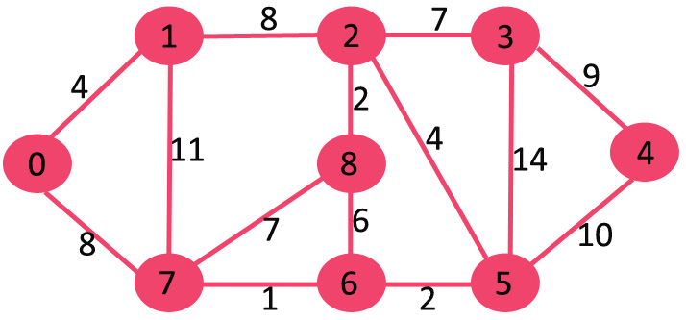
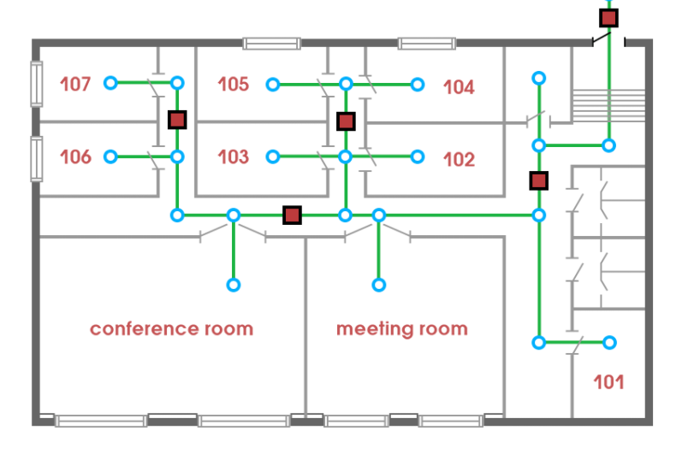
Implementation and Challenges-Navigating
Dijkstra Algorithm
Navigation Graph(mobidev)
Area relationship data

Slide 21
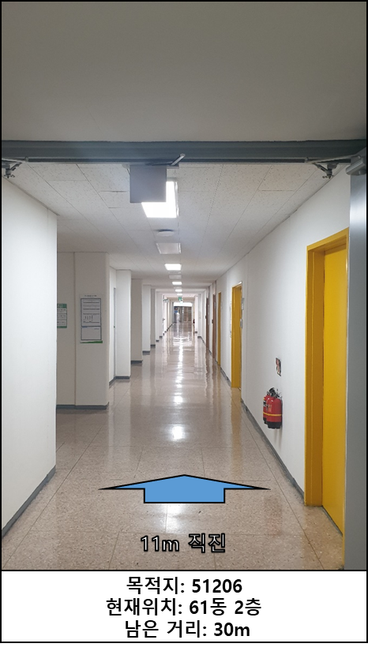
Implementation and Challenges-Navigating

Slide 22
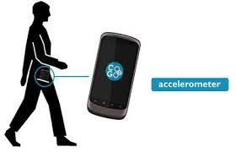
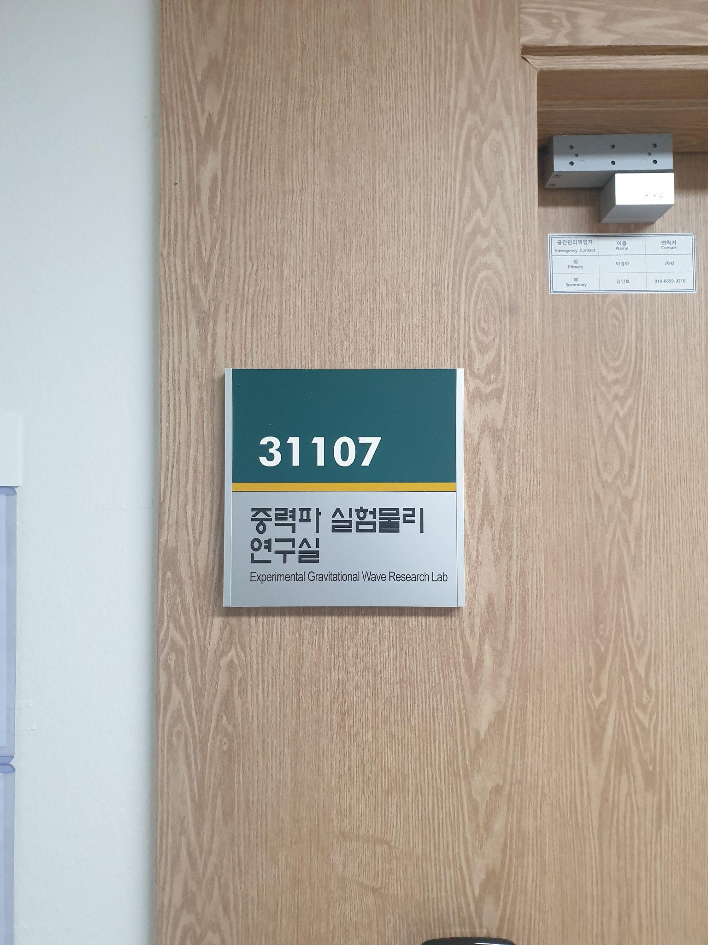
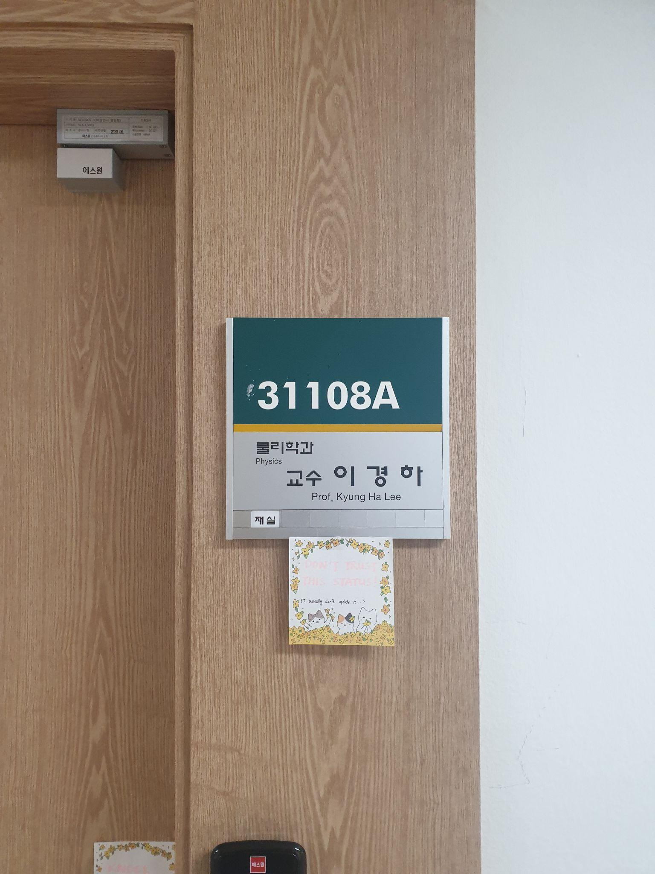
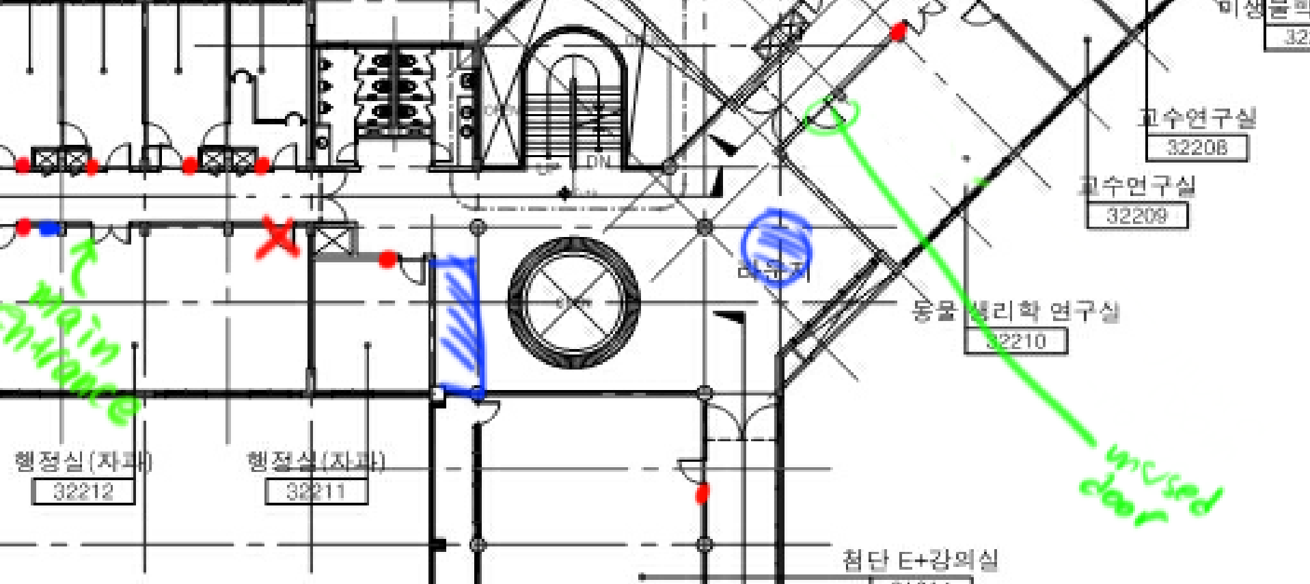
Implementation and Challenges-Navigating
Problem
-User movements recognize by device’s accelerometer but
there is an error compared to the actual movements.
-Location error occurs by
human being error(Inaccurate Mapping, Differences in marker scan position)

Slide 23
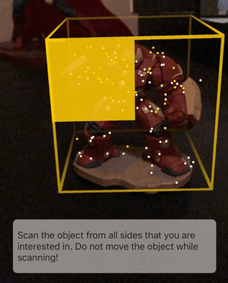
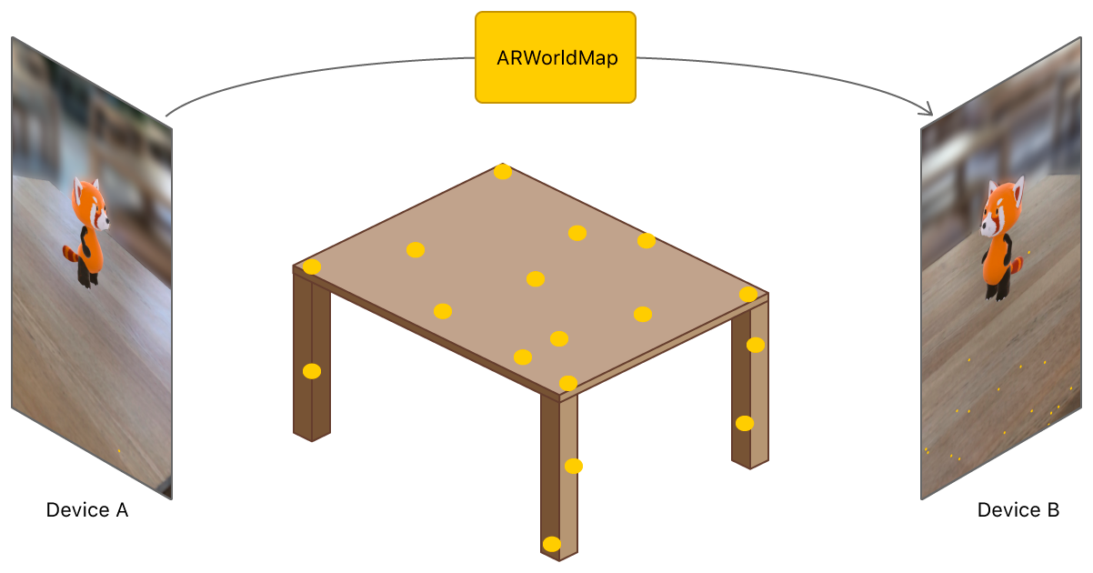
Implementation and Challenges-Navigating
Solution
-Use AR Anchor, which stores 3D feature information about a specific object or area
-Scan core location and resolve it while navigating
-Measure the distance between the camera and the anchor and use it to correct positional errors.

Slide 24
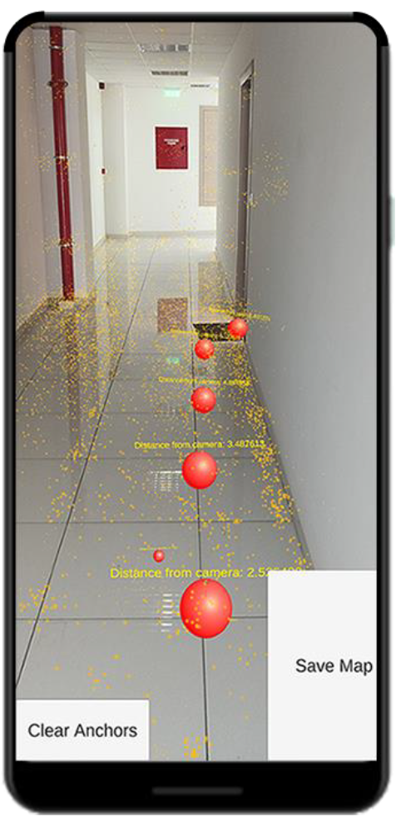
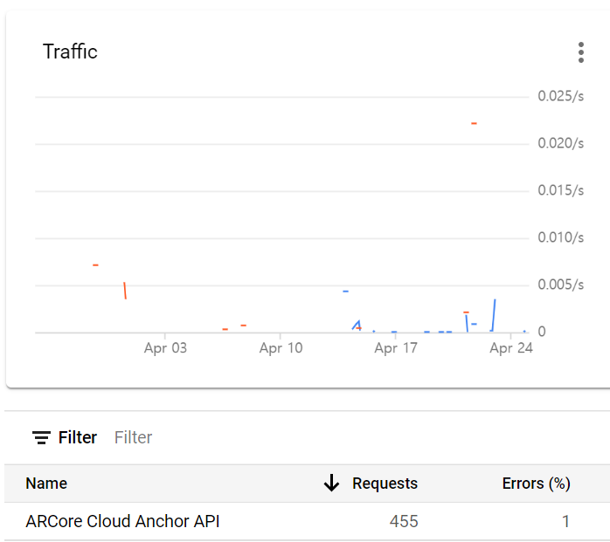

Implementation and Challenges-Navigating
An AR INDOOR POSITIONING SYSTEM Based on ANCHORS(2020)
Google AR Cloud Anchor

Slide 25
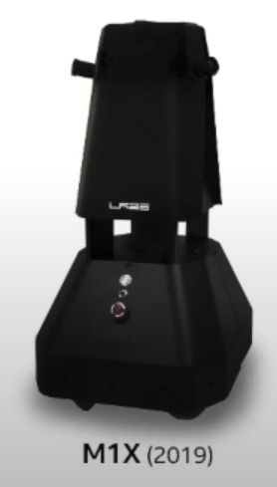
Limitation
-All mapping and scanning should be done passively by human
-It can cause human being errors like wrong mapping or position error
-Also takes a lot of time

Slide 26
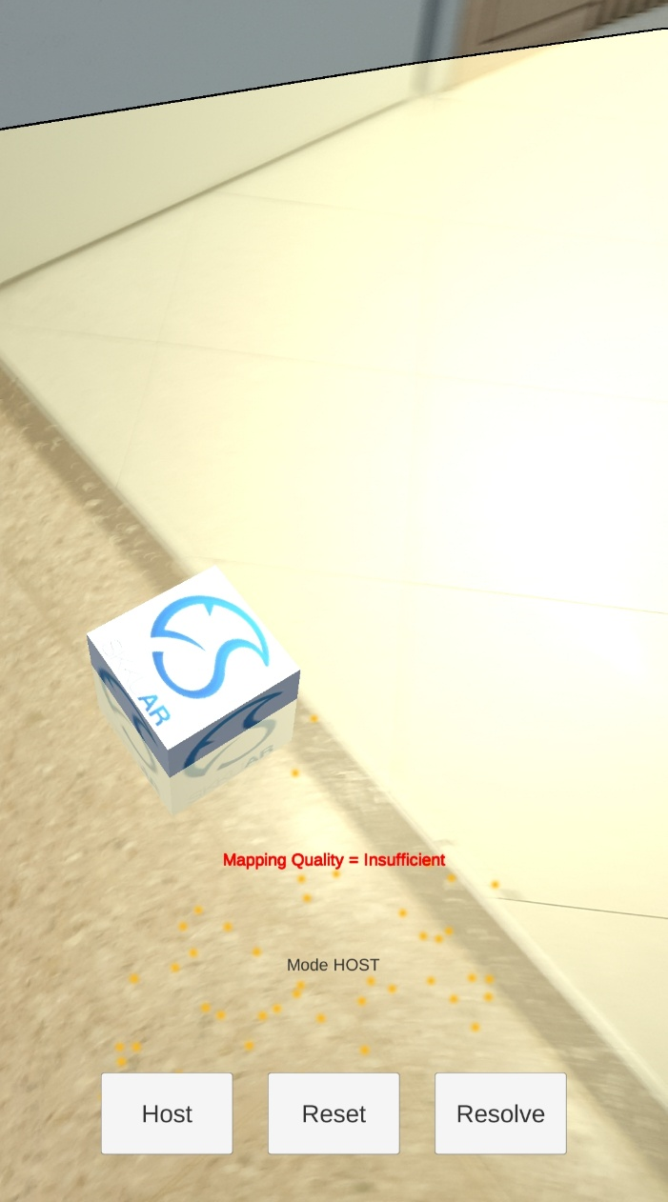
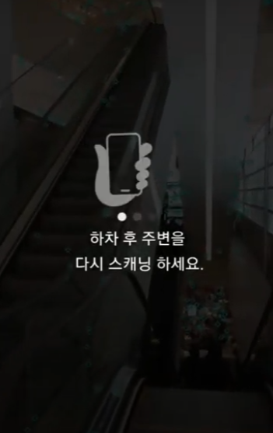
Limitation
-Scanning and Resolving AR anchor is vulnerable to changes in the light of the environment
-Location correction by AR anchor still does not guarantee an exact location
-Cannot handle floor-movement automatically

Slide 27
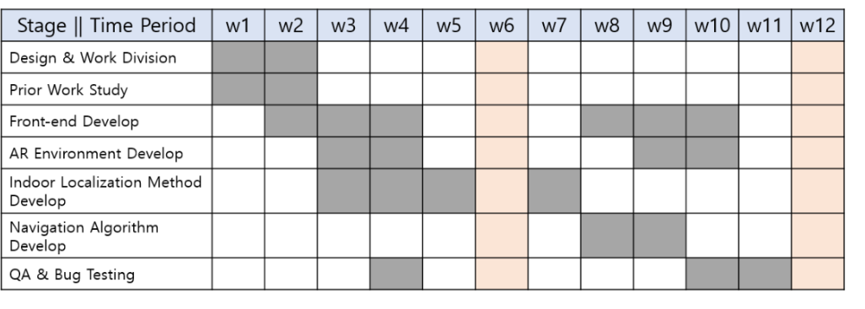
To Do

Slide 28
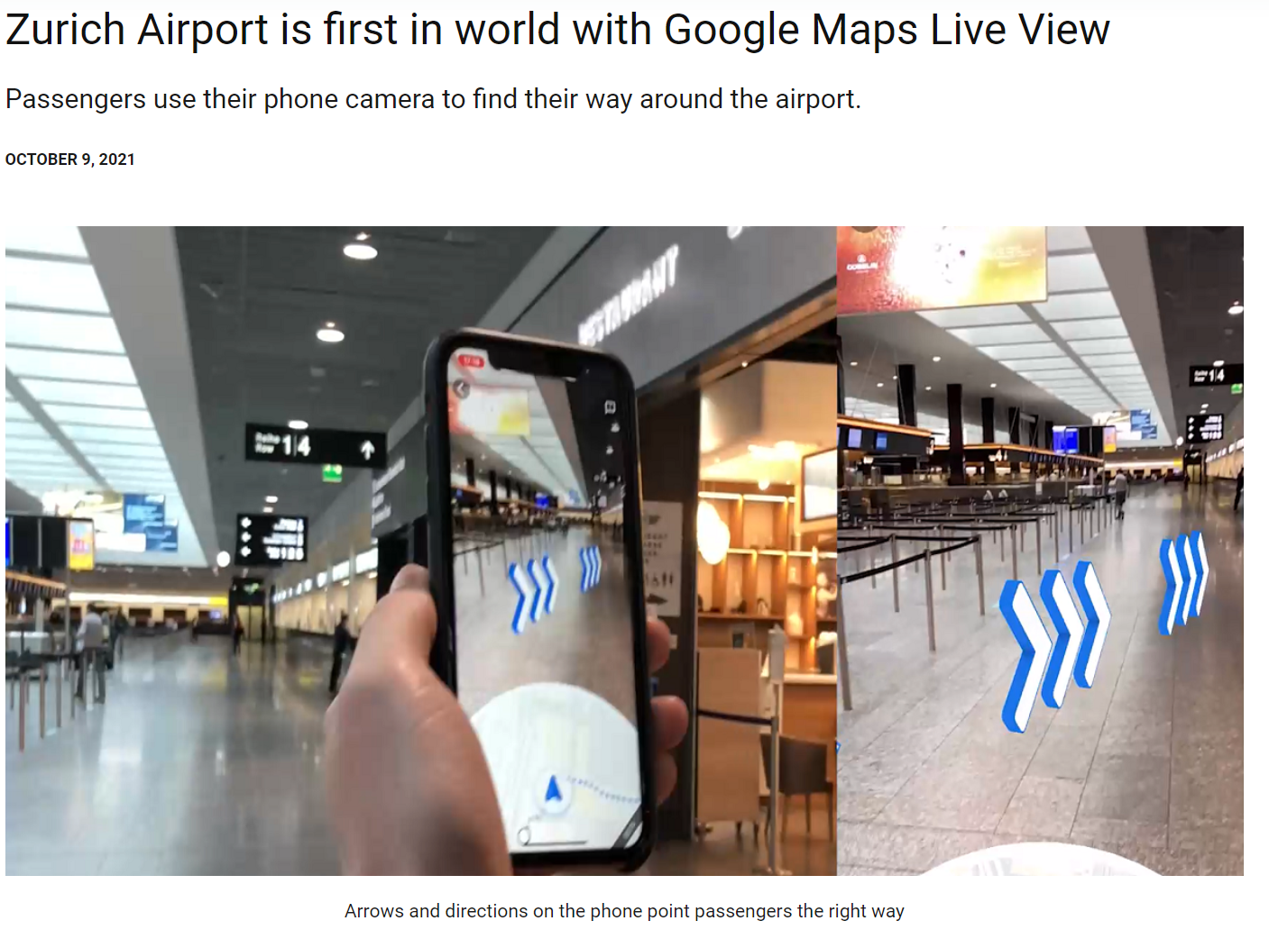
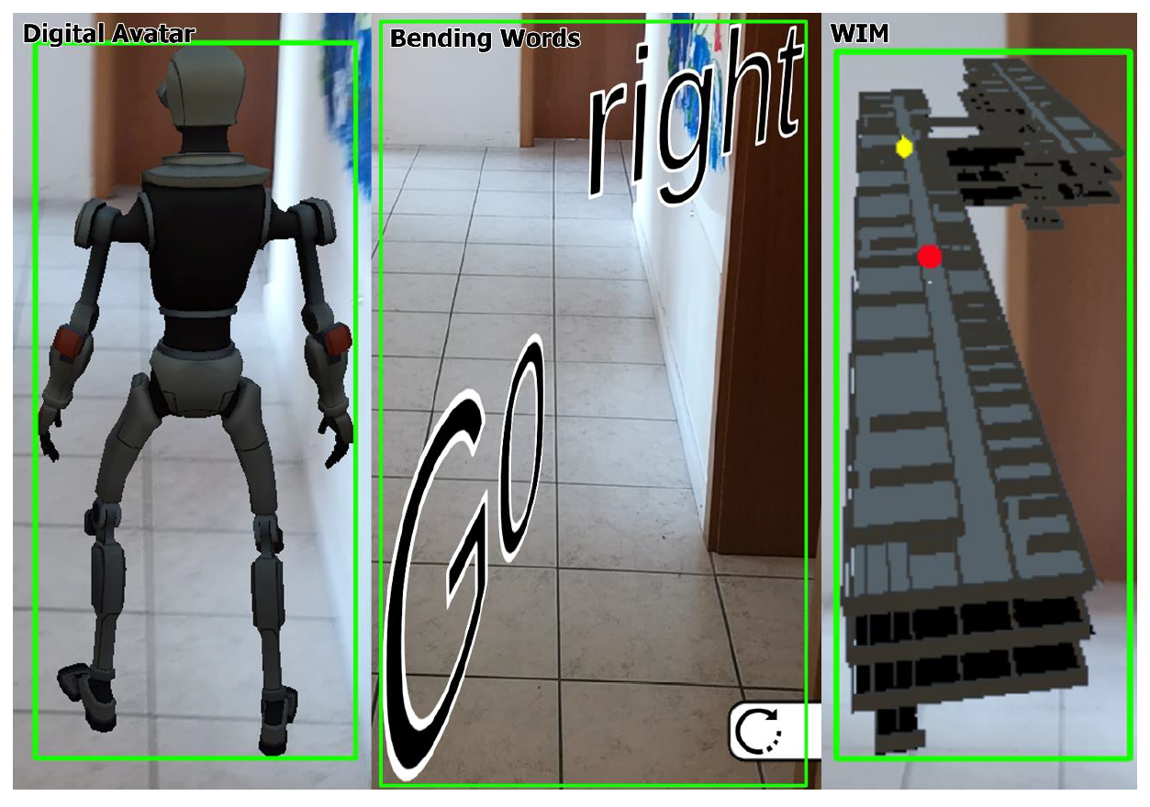
To Do
Google Maps Live View(2020)
Overcoming the problem of uncertain tracking errors in an AR navigation application(2020)

Slide 29
Demo

